Slide 1
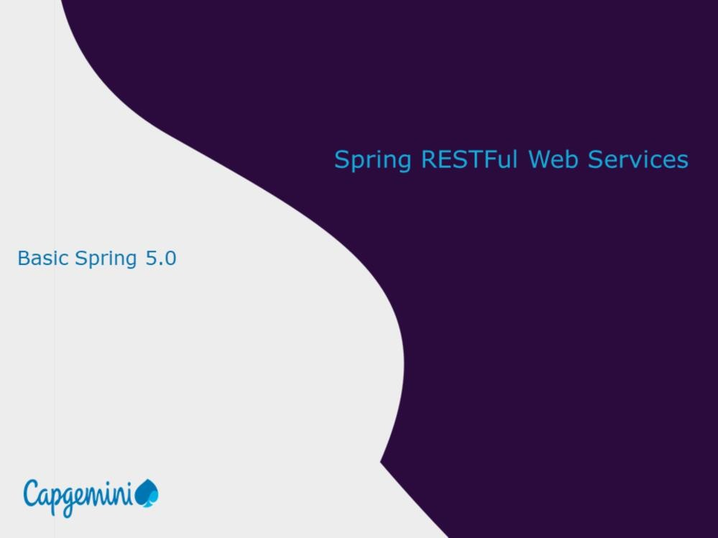
Introduction to Web Services (SOAP & REST)
Working with JAX - RS

Slide 2
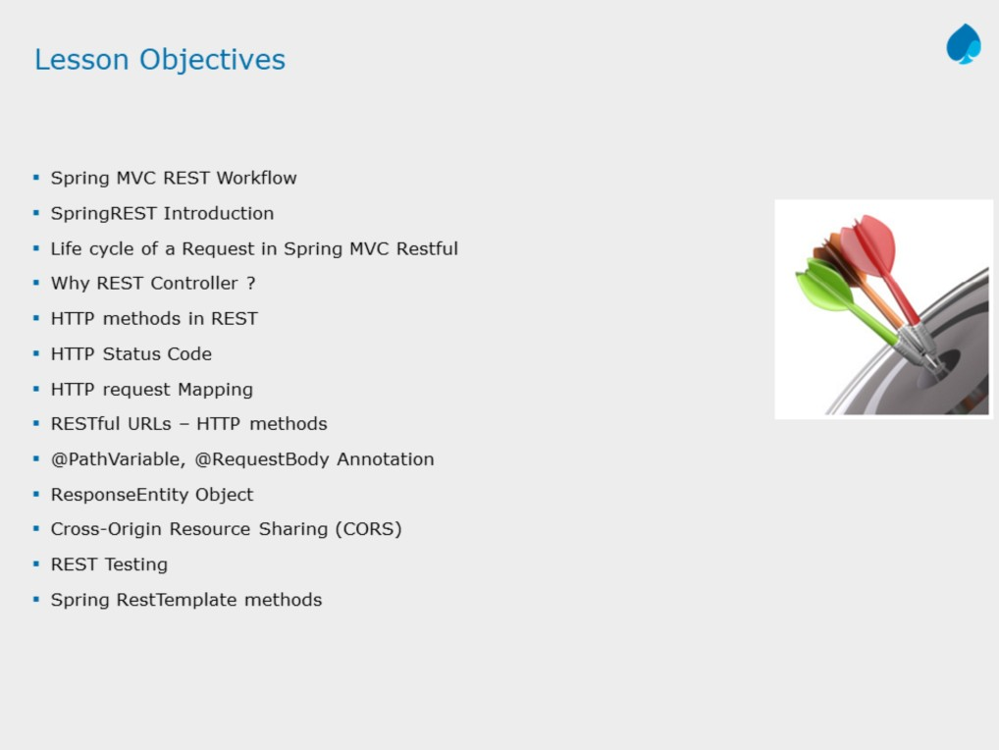
Introduction to Web Services (SOAP & REST)
Working with JAX - RS
Instructor Notes:

Slide 3
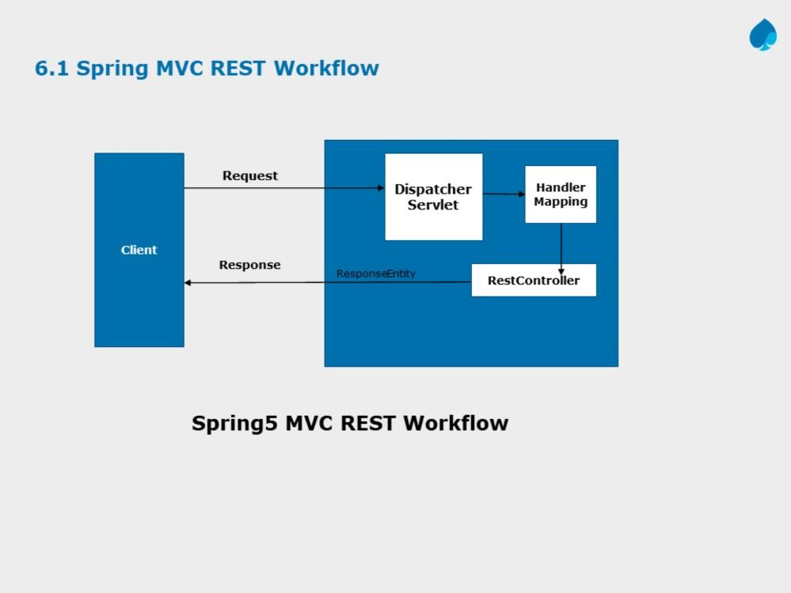
Introduction to Web Services (SOAP & REST)
Working with JAX - RS
Instructor Notes:

Slide 4
Spring’s annotation based MVC framework simplifies the process of creating RESTful web services. The key difference between a traditional Spring MVC controller and the RESTful web service controller is the way the HTTP response body is created. While the traditional MVC controller relies on the View technology, the RESTful web service controller simply returns the object and the object data is written directly to the HTTP response as JSON/XML
Spring MVC REST Workflow
The following steps describe a typical Spring MVC REST workflow:
The client sends a request to a web service in URI form.
The request is intercepted by the DispatcherServlet which looks for Handler Mappings and its type.
The Handler Mappings section defined in the application context file tells DispatcherServlet which strategy to use to find controllers based on the incoming request.
Spring MVC supports three different types of mapping request URIs to controllers: annotation, name conventions and explicit mappings.
Requests are processed by the Controller and the response is returned to the DispatcherServlet which then dispatches to the view.

Slide 5
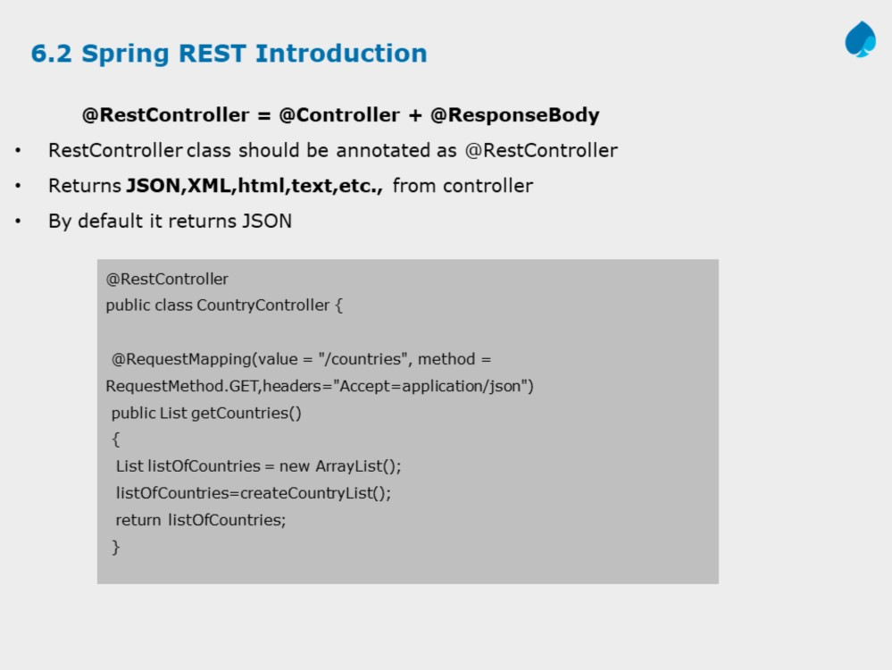
Introduction to Web Services (SOAP & REST)
Working with JAX - RS
Instructor Notes:
Spring has a list of HttpMessageConverters registered in the background. The responsibility of the HTTPMessageConverter is to convert the request body to a specific class and back to the response body again, depending on a predefined mime type. Every time an issued request hits @ResponseBody, Spring loops through all registered HTTPMessageConverters seeking the first that fits the given mime type and class, and then uses it for the actual conversion.

Slide 6
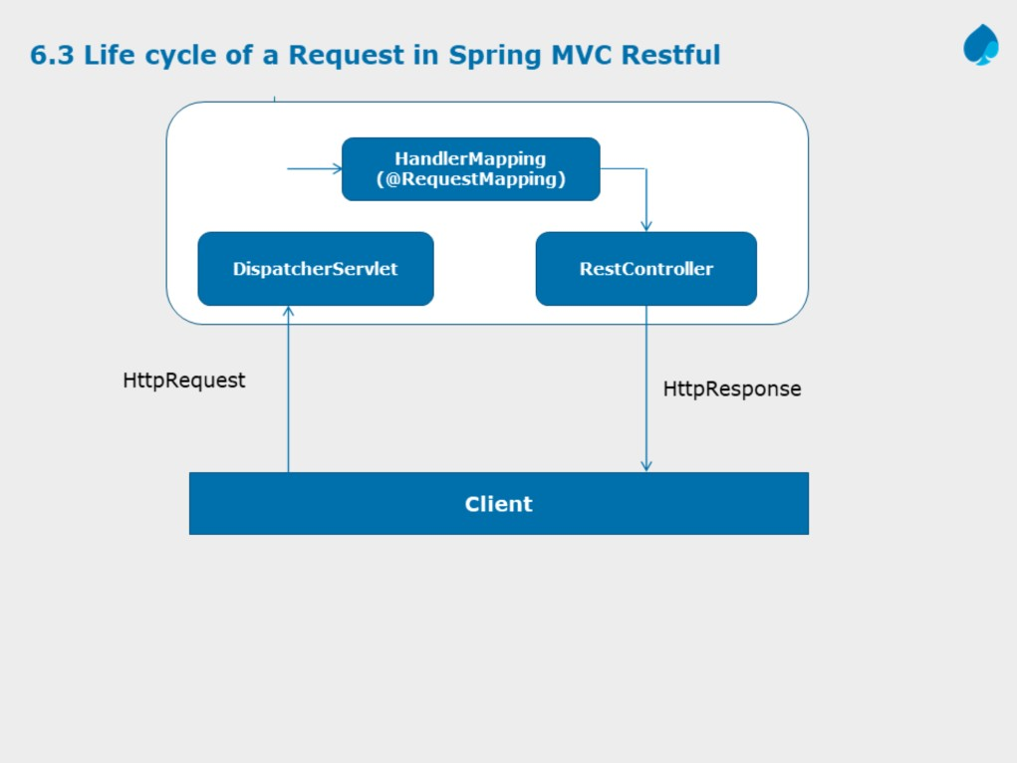
Introduction to Web Services (SOAP & REST)
Working with JAX - RS

Slide 7
REST(Representational State Transfer) is an architectural style with which Web Services can be designed that serves resources based on the request from client. A Web Service is a unit of managed code, that can be invoked using HTTP requests. You develop the core functionality of your application, deploy it in a server and expose to the network. Once it is exposed, it can be accessed using URI's through HTTP requests from a variety of client applications. Instead of repeating the same functionality in multiple client (web, desktop and mobile) applications, you write it once and access it in all the applications.
In the above diagram, from the time that a request is received by Spring until the time that a response is returned to the client, many pieces of Spring Restful webservices are involved.

Slide 8
The process starts when a client (typically a web browser) sends a request. It is first received by a DispatcherServlet. Like most Java-based MVC frameworks, Spring MVC uses a front-controller servlet (here DispatcherServlet) to intercept requests. This in turn delegates responsibility for a request to other components of an application for actual processing.
The Spring MVC uses a Controller component for handling the request. But a typical application may have several controllers. To determine which controller should handle the request, DispatcherServlet starts by querying one or more HandlerMappings. A HandlerMapping typically maps URL patterns to RestControllers.
Once the DispatcherServlet has a appropriate RestController selected, it dispatches the request to that Controller which performs the business logic (a well-designed RestController object delegates responsibility of business logic to one or more service objects). Upon completion of business logic, HTTPResponse is generated and sent back to the client.

Slide 9
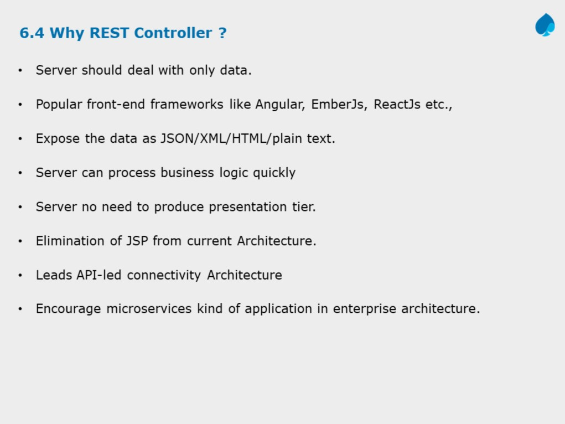
Introduction to Web Services (SOAP & REST)
Working with JAX - RS
Instructor Notes:

Slide 10
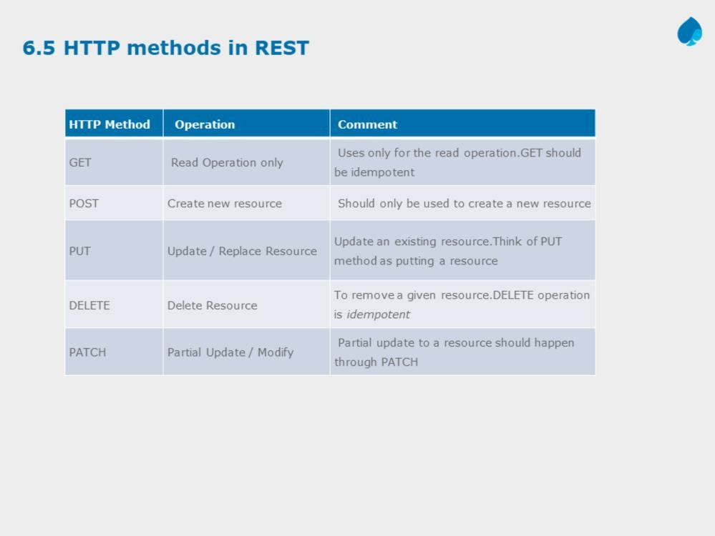
Introduction to Web Services (SOAP & REST)
Working with JAX - RS
Instructor Notes:

Slide 11
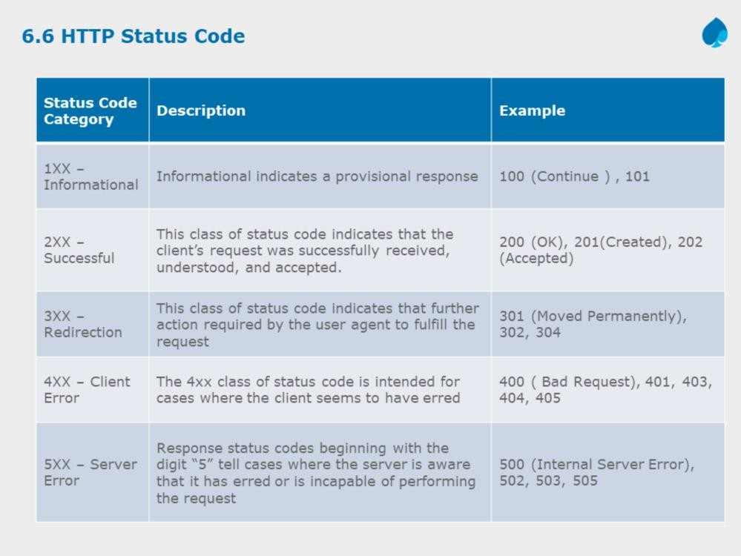
Introduction to Web Services (SOAP & REST)
Working with JAX - RS
Instructor Notes:

Slide 12
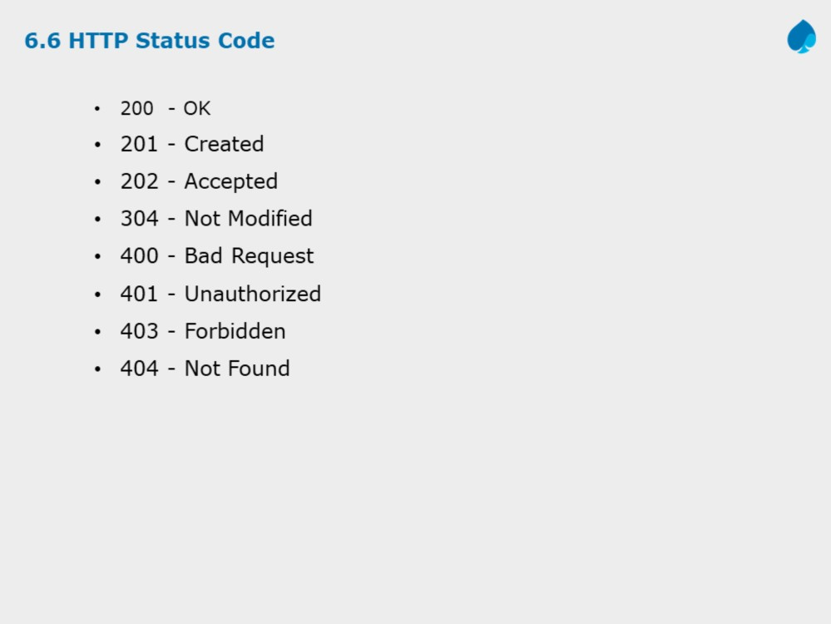
Introduction to Web Services (SOAP & REST)
Working with JAX - RS

Slide 13
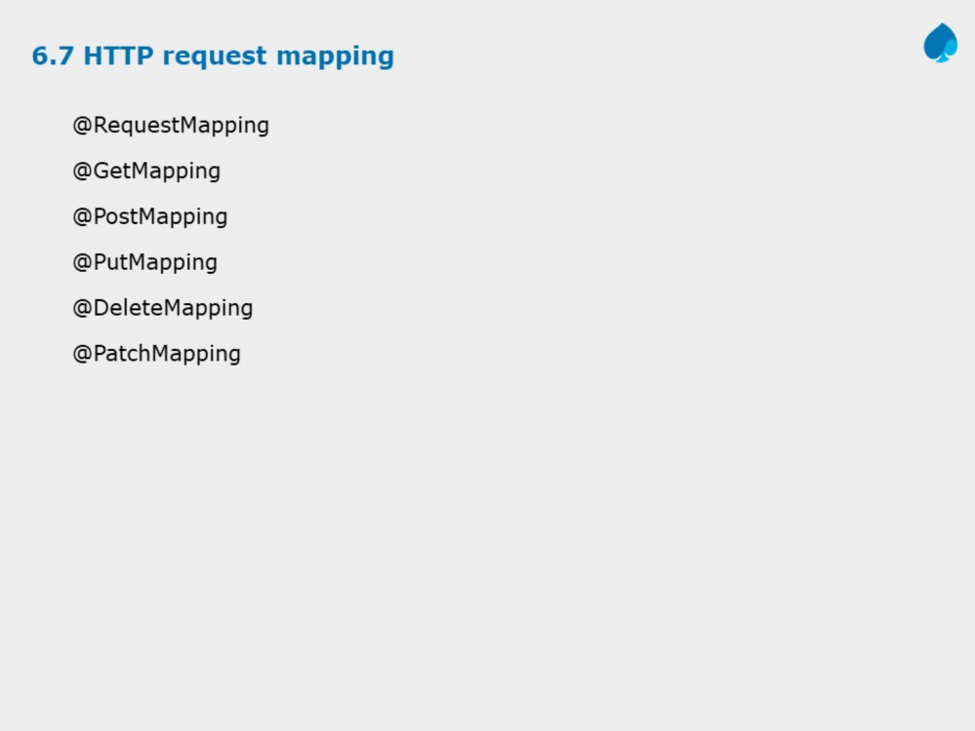
Introduction to Web Services (SOAP & REST)
Working with JAX - RS

Slide 14
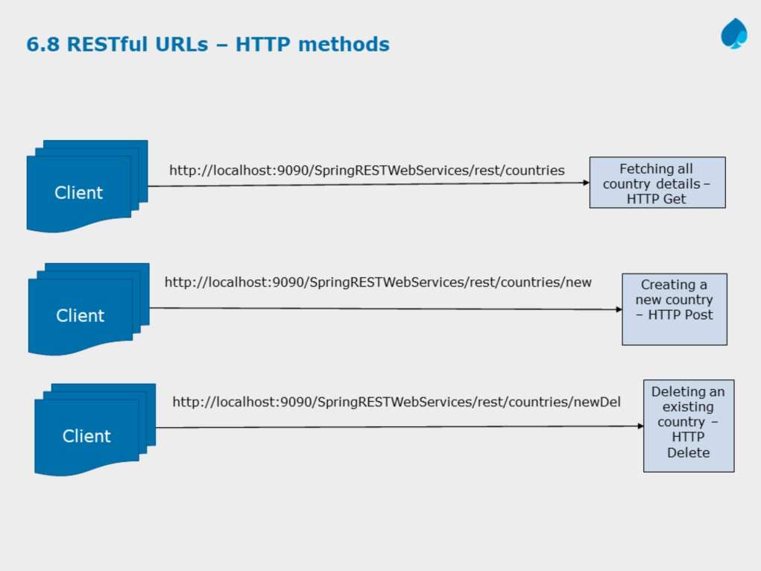
Introduction to Web Services (SOAP & REST)
Working with JAX - RS

Slide 15
The slide demonstrates different RESTful URLs with respect to different HTTP methods.
Demo: SpringRESTWebServices can be used as a reference.
Note: At times if the HTTP Get is used over a couple of RestController methods it has to be combined with URL patterns to create unique identifications.
In the above slide first URL pattern demonstrates : HTTP Get method to fetch all country details.
Similarly if details for a particular country need to be fetched then the country id can be appended in URL and extracted via the @PathVariable
http://localhost:9090/SpringRESTWebServices/rest/countries/3 -> With this URL country details are fetched for country Id = 3
The second URL pattern demonstrates : HTTP Post method to create a new country
The third URL pattern demonstrates : HTTP Delete method to delete an existing country
Note: As HTML supports only Get and Post methods for the method attribute in the form tag; we also need to map the HTTP PUT(update) and HTTP DELETE (delete) methods to update and delete the resources respectively.

Slide 16
For this Spring provides us with a Filter-mapping which is to be given in web.xml file:
<filter>
<filter-name>httpMethodFilter</filter-name>
<filter-class>org.springframework.web.filter.HiddenHttpMethodFilter</filter-class>
</filter>
<filter-mapping>
<filter-name>httpMethodFilter</filter-name>
<servlet-name>dispatcher</servlet-name>
</filter-mapping>
By using this Spring in-built filter the different methods of HTTP specification will be mapped to their actual HTTP implementations.
Here the filter will be intercepted for all the requests coming to DispatcherServlet.
Also in the JSP pages for updating and deleting a country need to pass a HTML hidden parameter : For example
<input type="hidden" name="_method" value="delete"/> to pass the “real” HTTP method to Spring Rest Controller.

Slide 17
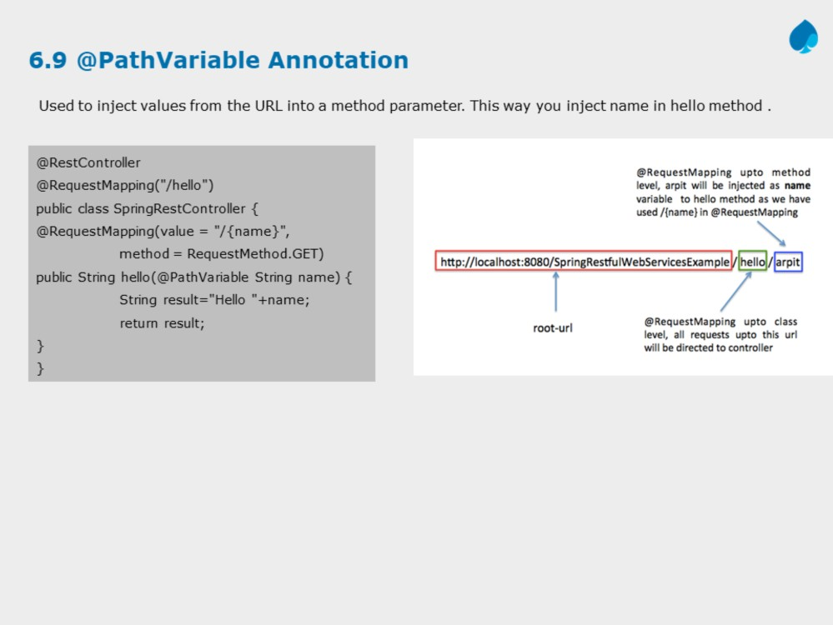
Introduction to Web Services (SOAP & REST)
Working with JAX - RS

Slide 18
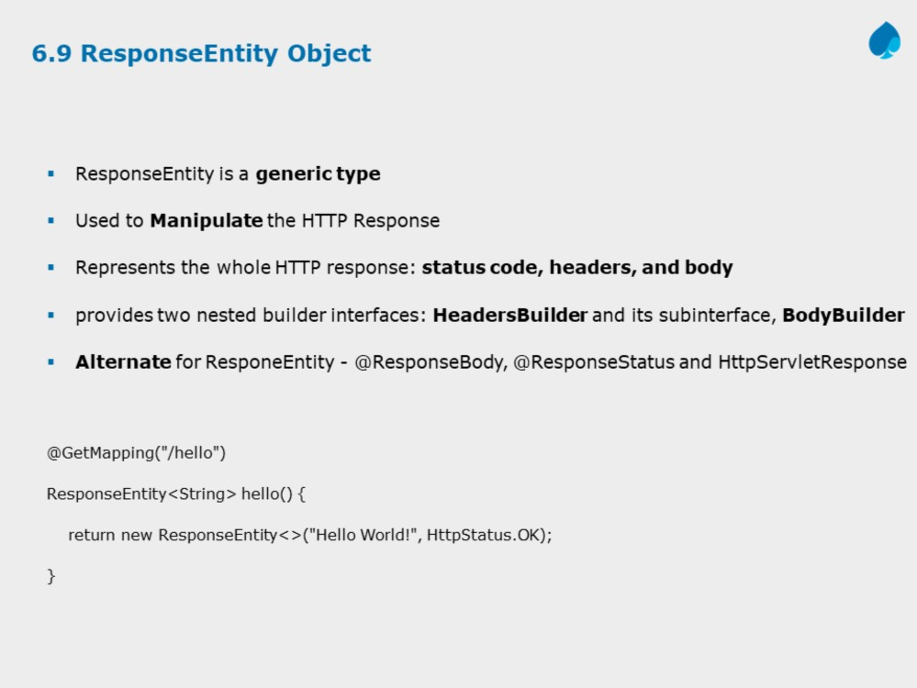
Introduction to Web Services (SOAP & REST)
Working with JAX - RS
Instructor Notes:

Slide 19
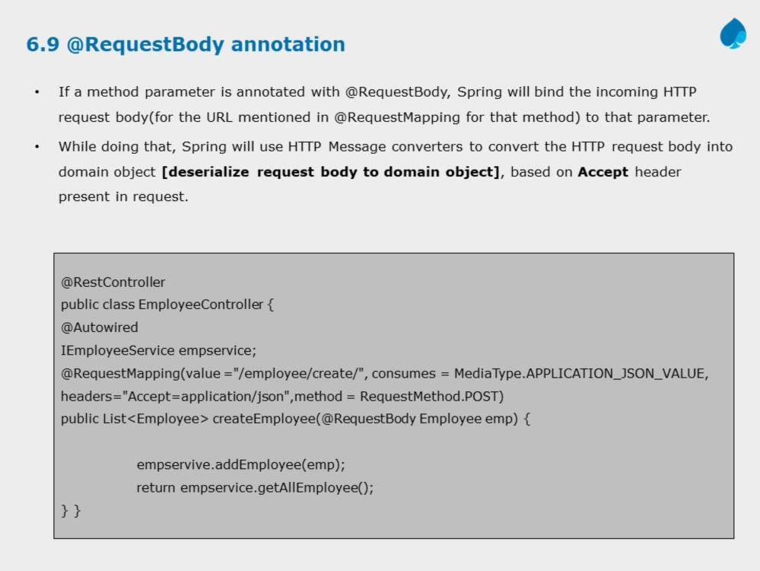
Introduction to Web Services (SOAP & REST)
Working with JAX - RS

Slide 20
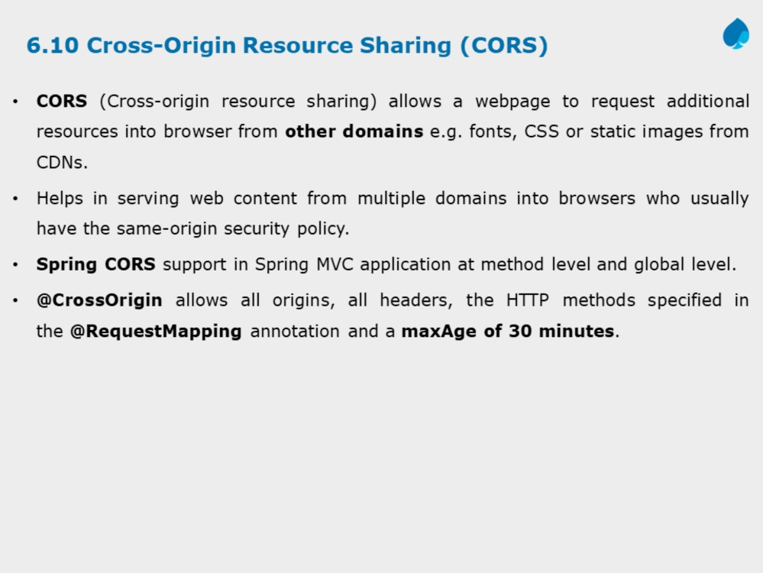
Introduction to Web Services (SOAP & REST)
Working with JAX - RS
Instructor Notes:

Slide 21
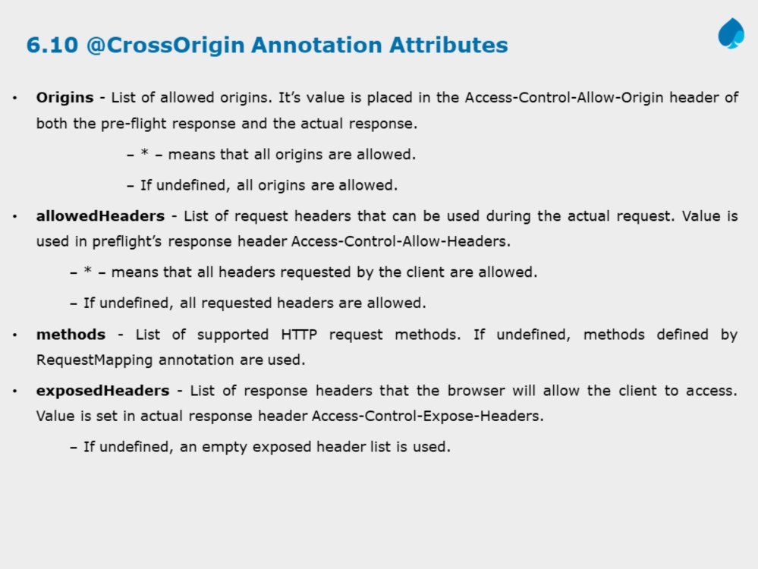
Introduction to Web Services (SOAP & REST)
Working with JAX - RS
Reference : https://developer.mozilla.org/en-US/docs/Web/HTTP/CORS

Slide 22
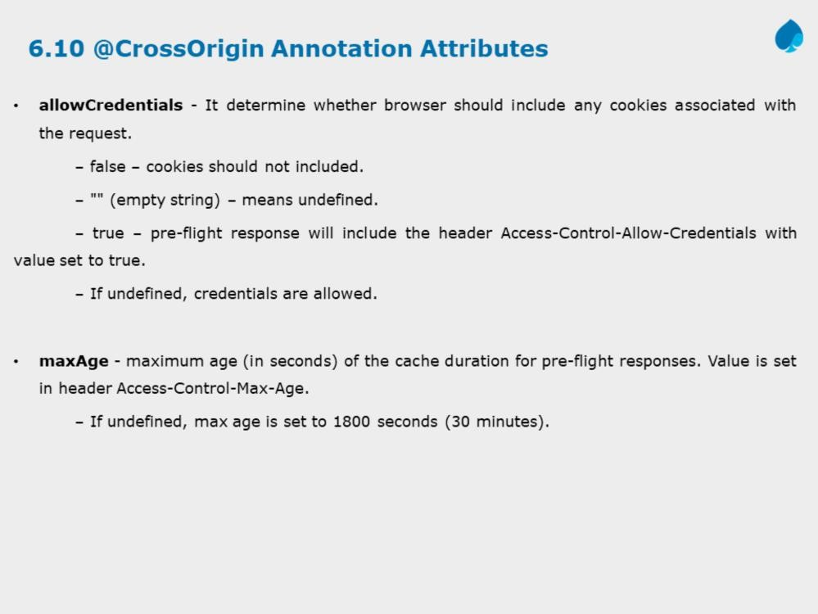
Introduction to Web Services (SOAP & REST)
Working with JAX - RS
Instructor Notes:

Slide 23
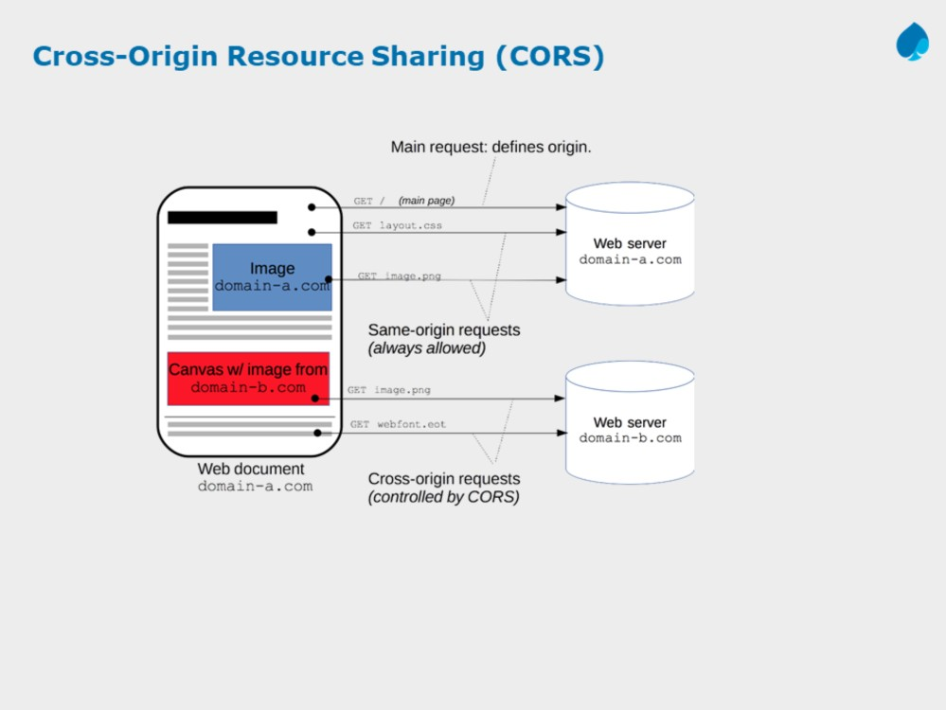
Introduction to Web Services (SOAP & REST)
Working with JAX - RS
Instructor Notes:
Reference : https://developer.mozilla.org/en-US/docs/Web/HTTP/CORS
The CORS mechanism supports secure cross-domain requests and data transfers between browsers and web servers. Modern browsers use CORS in an API container such as XMLHttpRequest or Fetch to help mitigate the risks of cross-origin HTTP requests.

Slide 24
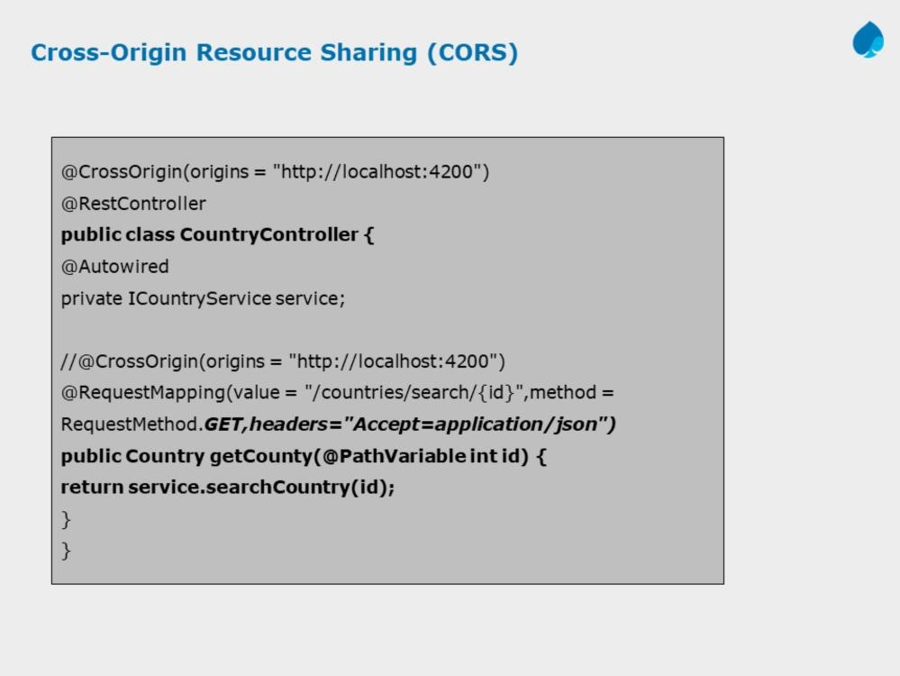
Introduction to Web Services (SOAP & REST)
Working with JAX - RS

Slide 25
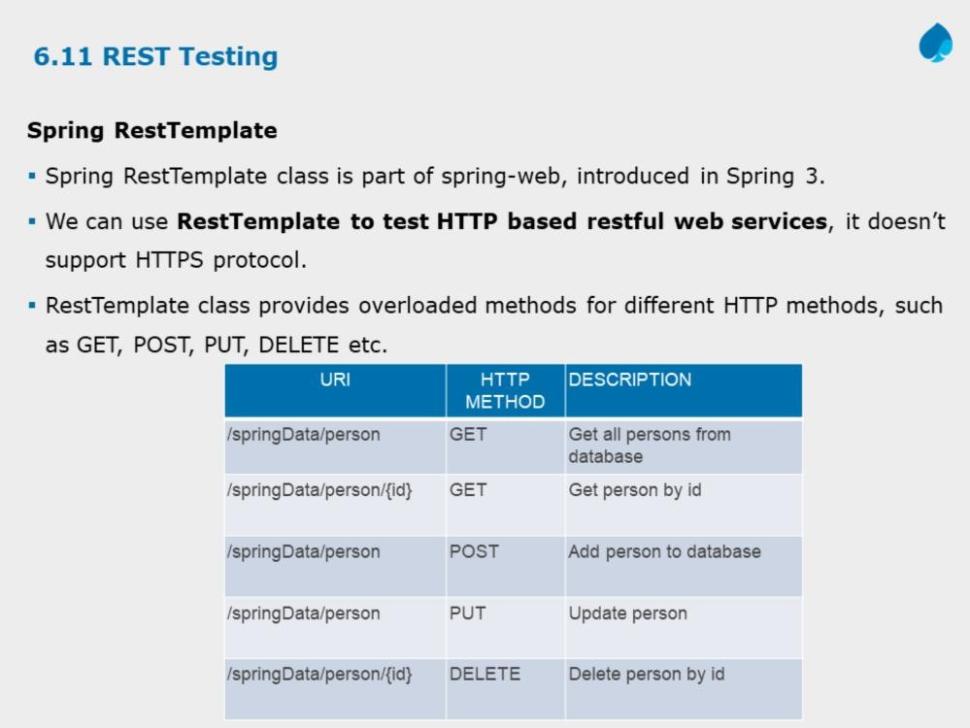
Introduction to Web Services (SOAP & REST)
Working with JAX - RS
Instructor Notes:

Slide 26
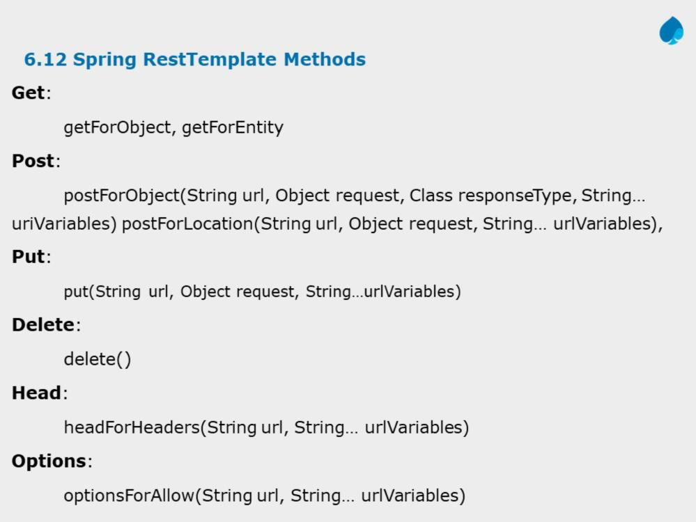
Introduction to Web Services (SOAP & REST)
Working with JAX - RS

Slide 27
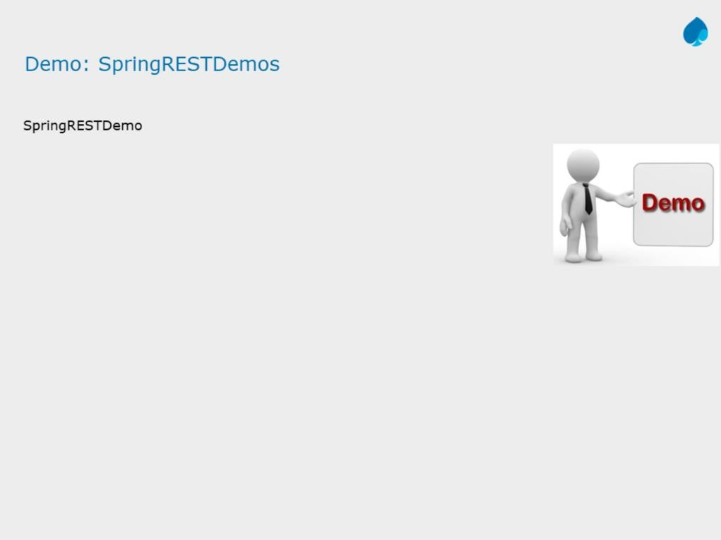
Introduction to Web Services (SOAP & REST)
Working with JAX - RS

Slide 28
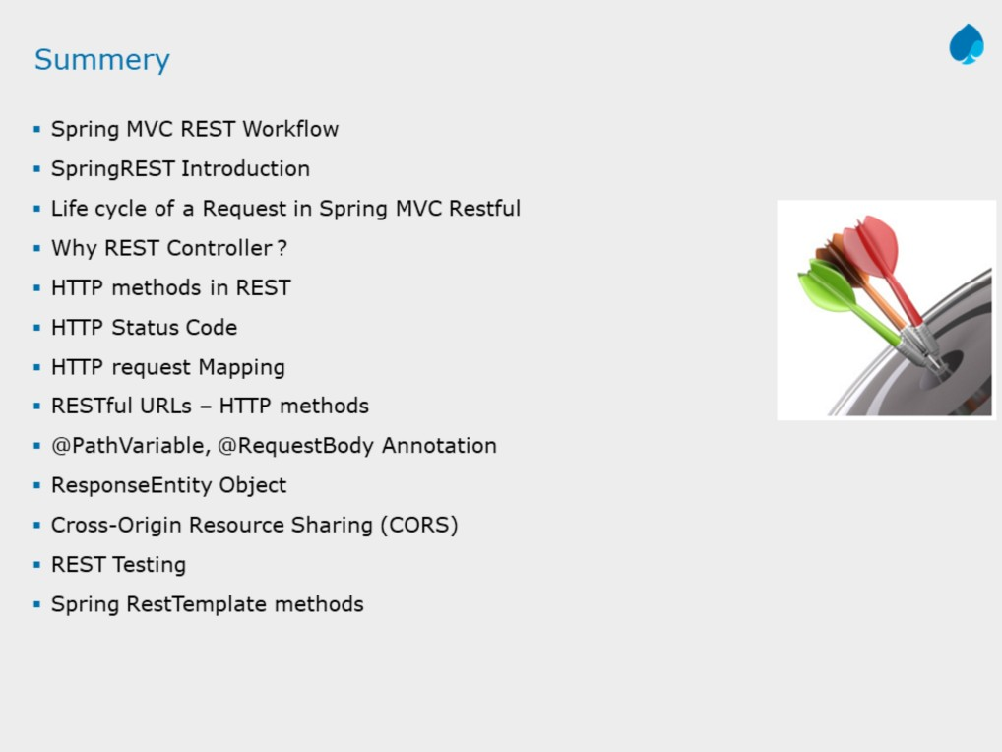
Introduction to Web Services (SOAP & REST)
Working with JAX - RS
Instructor Notes:

Slide 29
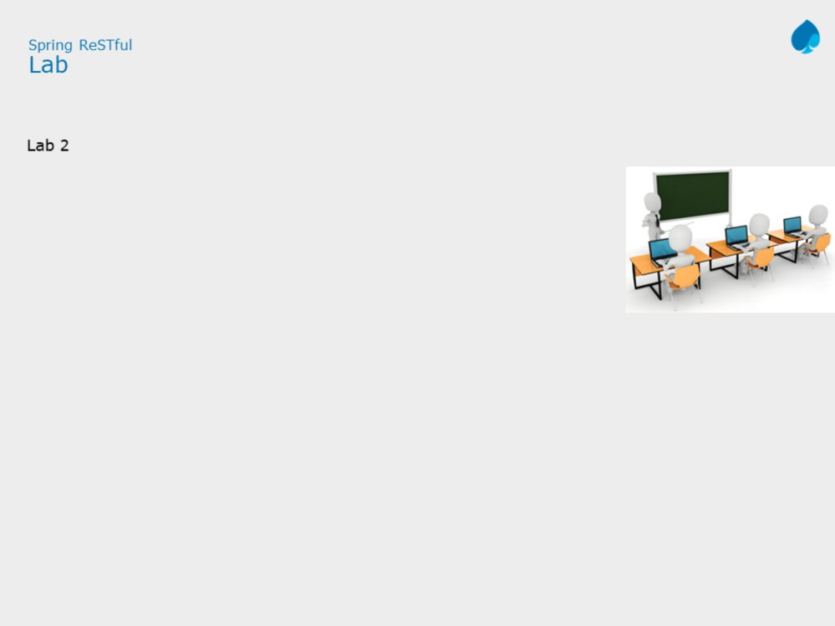
Introduction to Web Services (SOAP & REST)
Working with JAX - RS
Add the notes here.

Slide 30
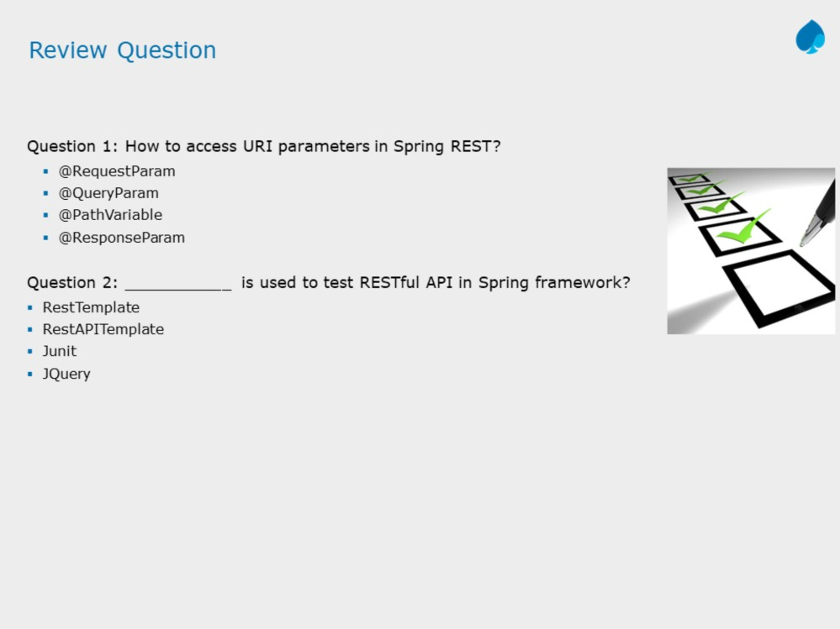
Introduction to Web Services (SOAP & REST)
Working with JAX - RS
Instructor Notes:
Question 1: Option 1,
Option 2
Question 2: True

Slide 31
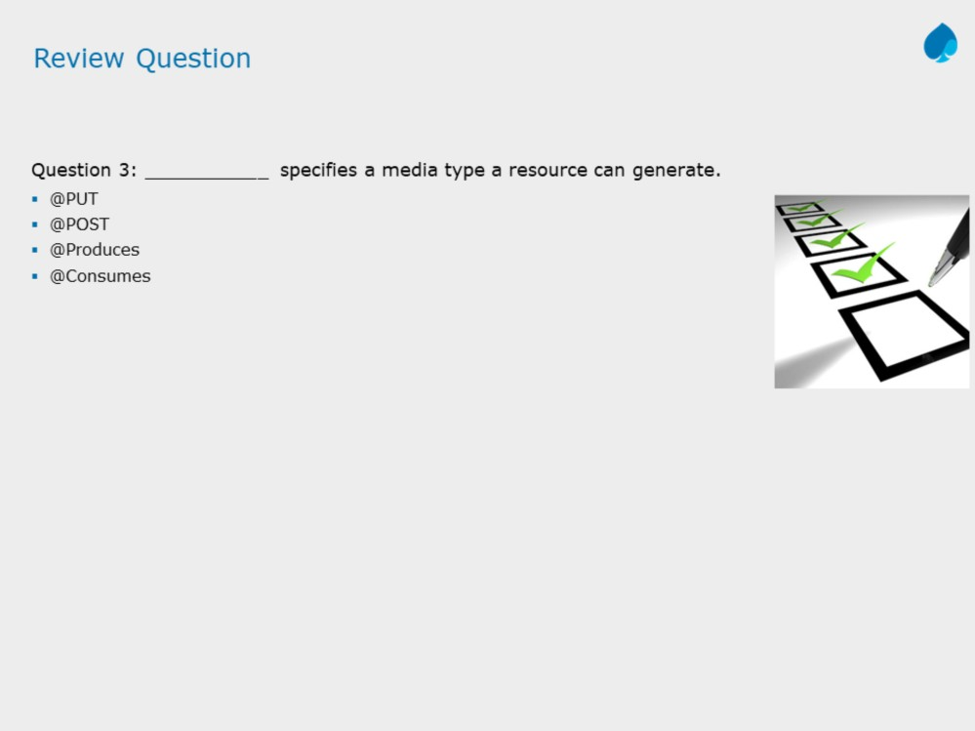
Introduction to Web Services (SOAP & REST)
Working with JAX - RS
Instructor Notes:
Question 3: @Produces

